Slide 1

RiverNorth Consultants
Girish Sharma| Renu Choudhary| Swatik Ghosh| Tavish Gulati

Slide 2
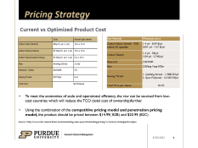
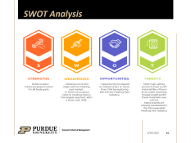

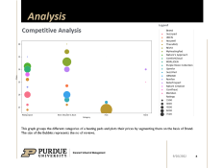
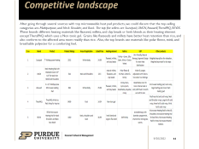
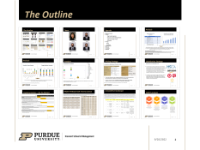
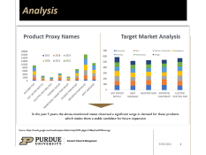
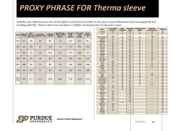
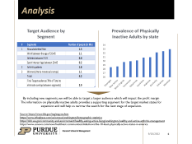
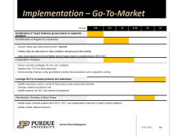
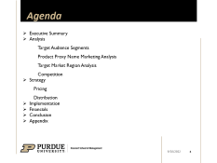
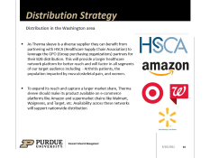
The Outline

Slide 3




Team
Renu Choudhary, Director-Consulting
Swatik Ghosh, Data Scientist
Girish Sharma, Marketing Analyst
Tavish Gulati, Financial Consultant

Slide 4
Agenda
Executive Summary
Analysis
Target Audience Segments
Product Proxy Name Marketing Analysis
Target Market Region Analysis
Competition
Strategy
Pricing
Distribution
Implementation
Financials
Conclusion
Appendix

Slide 5
Executive Summary
An excellent “Go-to-Market” Strategy is the challenge that Therma Sleeve needs to address for a successful market launch of their innovative and cost-effective solution to musculoskeletal pain. Recent studies indicate more than 50% of new businesses shut shop in less than 5 years due to a lack of a good launch or growth plan. Go-to-market strategies are paramount in today’s marketplace with intense competition, the need to launch new products and services at record speed, and the demand for delivering ROI (return on investment). Hence, to develop a powerful go-to-market strategy, our recommendation is to focus on a few key components including identifying and expanding the scope of the target audience to alternative applications along musculoskeletal pain, determining, and improving their current positions against the competition for product feature and competitive pricing along with identification of local and national distribution channels to reach a larger audience at lower cost and shorter time span.
Following an in-depth analysis, we understood that the Therma Sleeve product offers a unique solution targeting several pain areas single-handedly, and this USP combined with its lower cost than the competition can capture a bigger market share than initially anticipated. We narrowed down the target audience to the working class, experiencing musculoskeletal disorders due to long hours of sitting or repetitive muscle-intensive movement like on assembly lines in manufacturing units. Based on sports injury data, we have also included sports players in the target audience. Women below the age of 45 who might experience menstrual cramps, and arthritis patients are the remaining two components of our target market. Our competition study revealed that the most-selling microwavable heating pads belong to the Multipurpose or Neck, Back, and Shoulder category. These top-selling products have an outer covering of comforting materials like mink, polar fleece, or breathable polyester. Unlike Therma Sleeve’s product, they mostly have a filling of flaxseeds, millets, and clay beads. Flaxseeds have a better heat-retention and conform to the body better than rice. The cost analysis also tells us that the price to produce each sleeve can go down to approximately $2.9 resulting in a significant decrease in production cost. An expansion strategy could focus on the prevalence of identified factors included to evaluate the target audience and regions on sedentary life etc. Switching to procuring material in bulk from lower-cost countries and outsourcing the product manufacturing would help reduce the cost further and remain competitive.
Our recommendation is to adopt the proposed Go to Market Strategy, as this offers unique positions against the competition. Therma Sleeve needs to leverage its unique position of being a diverse – women-owned business and partner with government affiliate organizations to gain wider recognition. To remain competitive in the market they need to
Reduce total cost of ownership by buying in bulk
Partner with GPOs and supermarket channels
Develop and leverage statistical methods to identify locations for expansion

Slide 6
Analysis
Target Audience by Segment
Prevalence of Physically Inactive Adults by state
By including new segments, we will be able to target a larger audience which will impact the profit margin
The information on physically inactive adults provides a supporting argument for the target market states for expansion and will help us narrow the search for the next stage of expansion.
Source https://www.bls.gov/eag/eag.wa.htm
https://www.infoplease.com/us/census/washington/demographic-statistics
https://doh.wa.gov/community-and-environment/healthy-eating-active-living/washington-healthy-and-active-arthritis-management
https://www.usnews.com/news/healthiest-communities/slideshows/the-10-least-physically-active-states-in-america

Slide 7
Analysis
Product Proxy Names
Target Market Analysis
In the past 5 years, the above-mentioned states observed a significant surge in demand for these products which makes them a viable candidate for future expansion
Source: https://trends.google.com/trends/explore?date=today%205-y&geo=US&q=heat%20massage

Slide 8
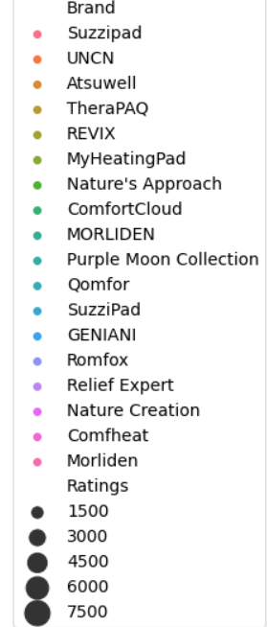
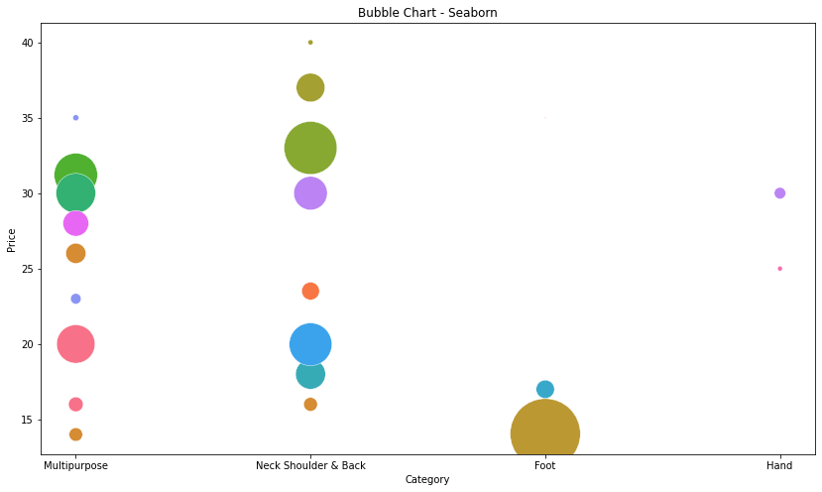
Analysis
Competitive Analysis
Legend
This graph groups the different categories of a heating pads and plots their prices by segmenting them on the basis of Brand. The size of the Bubbles represents the no of reviews.

Slide 9
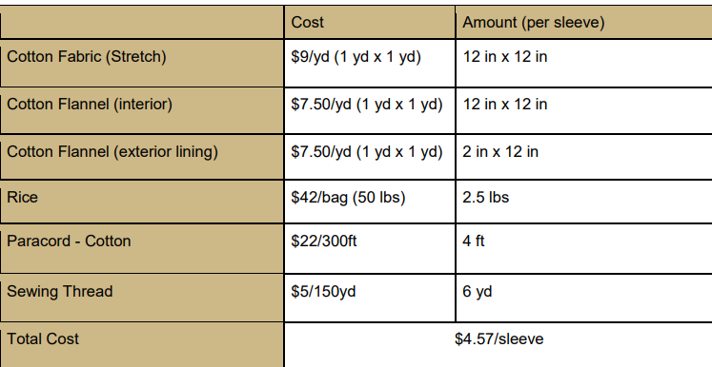
Pricing Strategy
Current vs Optimized Product Cost
Raw Material | Wholesale price
Cotton Fabric Stretch - 95% cotton 5% spandex | 1-4 yd - 8.99 $/yd 300+ yd - 7.37 $/yd
Cotton Flannel | 1-4 yd - 5$/yd 120+yd - 3.74$/yd
Paracord | 22$/300ft
Rice | 25$/bag 1bag-50lbs
Sewing Thread | 1. Quilting thread - 1.98$/325yd 2. Spun Polyester - 0.32$/150yd
Total Price per sleeve | $2.83
To meet the economies of scale and operational efficiency, the raw can be sourced from low-cost countries which will reduce the TCO (total cost of ownership)further.
Using the combination of the competitive pricing model and penetration pricing model, the product should be priced between $14.99( B2B) and $20.99 (B2C)
Source: https://www.bdc.ca/en/articles-tools/marketing-sales-export/marketing/pricing-5-common-strategies#costplus

Slide 10





Distribution Strategy
Distribution in the Washington area
As Therma sleeve is a diverse supplier they can benefit from partnering with HSCA (Healthcare Supply Chain Association) to leverage the GPO (Group purchasing organizations) partners for their B2B distribution. This will provide a larger healthcare network platform for better reach and will factor in all segments of our target audience including - Arthritis patients, the population impacted by musculoskeletal pain, and women.
To expand its reach and capture a larger market share, Therma sleeve should make its product available on e-commerce platforms like Amazon and supermarket chains like Walmart, Walgreens, and Target, etc. Availability across these networks will support nationwide distribution

Slide 11
Implementation – Go-To-Market
Weeks | 1-4 | 5-7 | 8 | 9-10 |  | 11 | 12
Identification of Target Audience groups based on segments identified
Identification of Region for expansion
Classify states and cities based on the segments Priorities states and cities based on high correlations with pricing and sales potential Using Linear regression to forecast highest demand regions based on variable pricing for B2B & B2C
Competitive Analysis
Devise sourcing strategies for low-cost countries Optimize the TCO for bulk production Devise pricing strategy using quantitative models like penetration and competitive pricing
Leverage SEO to increase presence and awareness
Identify Keywords or proxy words for the product name and product function Develop content on products and Identify partners for SEO and website development
Distribution Strategy & Next Steps
Identify major channel partners like HSCA, GPO, and supermarket channels to target a larger audience Identify similar national networks

Slide 12
Thank You

Slide 13
PROXY PHRASE FOR Therma sleeve
Arthritis pain relief has been one of the highest searched terms (29% ) in the past 5 years followed by heat massage(19%) and heating pad(17%). Therma sleeve has emerged as a highly searched product in the past 2 years.
Region | HOT WATER BOTTLE | HEAT MASSAGE | HEATING PADS | ARTHRITIS PAIN RELIEF | ELECTRIC HEATING PAD | AVERAGE
New Jersey | 87 | 80 | 89 | 89 | 78 | 85
Ohio | 70 | 84 | 85 | 100 | 80 | 84
District of Columbia | 89 | 69 | 78 | 65 | 100 | 80
Washington | 94 | 76 | 75 | 61 | 79 | 77
Nebraska | 71 | 67 | 63 | 94 | 77 | 74
Pennsylvania | 81 | 74 | 67 | 62 | 87 | 74
Oregon | 97 | 69 | 71 | 66 | 67 | 74
New York | 88 | 85 | 74 | 53 | 68 | 74
Connecticut | 85 | 73 | 79 | 55 | 73 | 73
Arkansas | 70 | 72 | 71 | 70 | 75 | 72
Wisconsin | 65 | 76 | 76 | 60 | 72 | 70
California | 81 | 64 | 65 | 54 | 78 | 68
Utah | 72 | 72 | 81 | 57 | 60 | 68
Mississippi | 62 | 73 | 61 | 67 | 67 | 66
Georgia | 70 | 54 | 69 | 53 | 77 | 65
Kentucky | 65 | 60 | 66 | 58 | 65 | 63
South Dakota |  | 63 | 69 | 91 | 90 | 63
Tennessee | 63 | 70 | 69 | 48 | 56 | 61
Nevada | 68 | 85 | 85 | 64 |  | 60
Iowa | 55 | 67 | 73 | 50 | 57 | 60
Alabama | 52 | 76 | 74 | 51 | 47 | 60
Louisiana | 59 | 54 | 72 | 42 | 72 | 60
Michigan | 67 | 86 | 76 | 66 |  | 59
Virginia | 74 | 90 | 75 | 51 |  | 58
North Carolina | 66 | 85 | 78 | 53 |  | 56
Missouri | 58 | 51 | 57 | 41 | 69 | 55
Alaska |  | 86 | 74 | 50 | 63 | 55
Illinois | 69 | 70 | 77 | 47 |  | 53
South Carolina | 60 | 75 | 79 | 48 |  | 52
North Dakota |  | 65 | 72 | 51 | 71 | 52
New Hampshire | 78 | 59 | 62 | 56 |  | 51
West Virginia |  | 68 | 65 | 56 | 52 | 48
Delaware |  | 56 | 59 | 49 | 61 | 45
Florida | 56 | 78 | 88 |  |  | 44
New Mexico | 72 | 72 | 73 |  |  | 43
Vermont |  | 100 | 100 |  |  | 40
Maine | 79 |  | 99 |  |  | 36
Massachusetts | 97 |  | 68 |  |  | 33
Kansas | 69 |  | 88 |  |  | 31
Colorado | 81 |  | 75 |  |  | 31
Texas | 60 |  | 93 |  |  | 31
Minnesota | 73 |  | 78 |  |  | 30
Indiana | 65 |  | 84 |  |  | 30
Hawaii |  | 65 | 78 |  |  | 29
Rhode Island | 100 |  |  |  |  | 20
Maryland | 86 |  |  |  |  | 17
Arizona | 65 |  |  |  |  | 13
Idaho | 61 |  |  |  |  | 12
Oklahoma | 52 |  |  |  |  | 10
Montana |  |  |  |  |  | 0
Wyoming
YEAR | HEATING PAD | HOT WATER BOTTLE | ELECTRIC HEATING PAD | THERMA SLEEVE | MENSTRUAL CRAMP PAIN RELIEF | CRAMPS PAIN RELIEF | ARTHRITIS PAIN RELIEF | HEAT MASSAGE
2017 | 631 | 148 | 264 | 547 | 133 | 430 | 857 | 821
2018 | 1629 | 679 | 427 | 1245 | 552 | 1517 | 2721 | 1853
2019 | 1578 | 703 | 434 | 868 | 433 | 1251 | 2996 | 1876
2020 | 2057 | 419 | 182 | 781 | 660 | 1484 | 3322 | 2157
2021 | 2243 | 704 | 517 | 784 | 416 | 1554 | 3679 | 2686
2022 | 1292 | 500 | 391 | 304 | 465 | 1018 | 2716 | 1608
Grand Total | 9430 | 3153 | 2215 | 4529 | 2659 | 7254 | 16291 | 11001

Slide 14
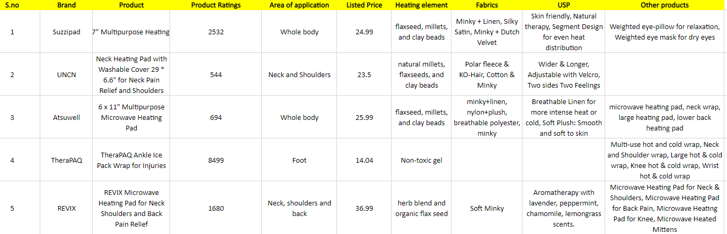
Competitive landscape
After going through several sources with top microwavable heat pad products, we could discern that the top-selling categories are Multipurpose, and Neck Shoulder, and Back. The top five sellers are Suzzipad, UNCN, Atsuwell, TheraPAQ, REVIX. These brands different heating materials like flaxseed, millets, and clay beads or herb blends as their heating element except TheraPAQ which uses a Non-toxic gel. Grains like flaxseeds and millets have better heat retention than rice, and also conform to the affected area more readily than rice. Also, the top brands use materials like polar fleece, mink, and breathable polyester for a comforting feel.

Slide 15
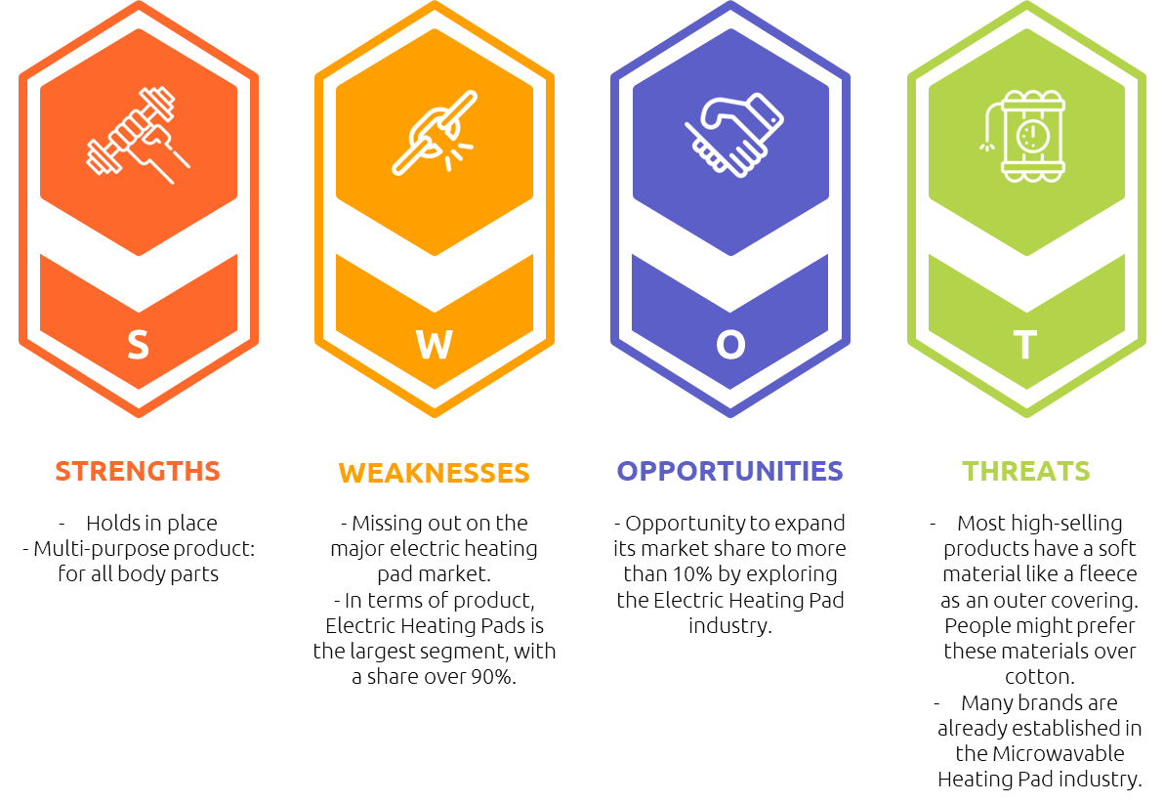
SWOT Analysis

